Slide 1
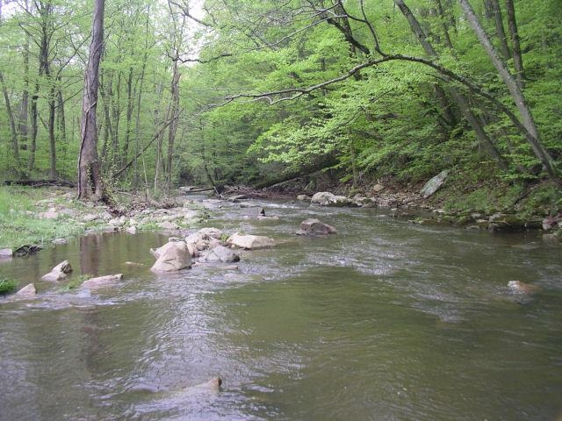
Loudoun Soil and Water Conservation District & Loudoun County
Non Agricultural Stream Riparian Buffer Planting Program

Slide 2
What is the Program?
A project to incentivize the planting of riparian buffers on land not eligible for funding through the Traditional State Agricultural Cost Share Program.
Private landowners, HOAs, Businesses, and other commercial sites are all eligible.

Slide 3
How do Buffers Help?
Forested buffers help filter sediment and nutrients before they reach the stream channel.
Trees help cool stream water, providing better habitat for insects, fish, and other wildlife.
Trees provide aesthetic benefits to properties.

Slide 4
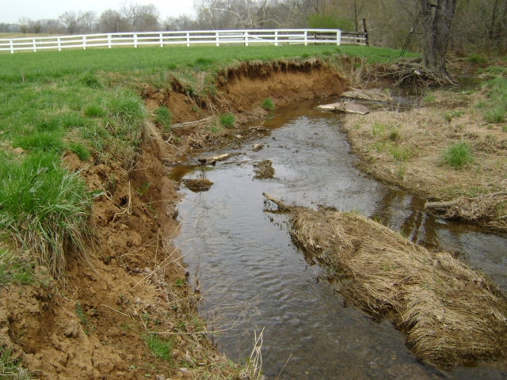
What areas need a buffer?
Un-forested areas with only short grasses or denuded areas.

Slide 5
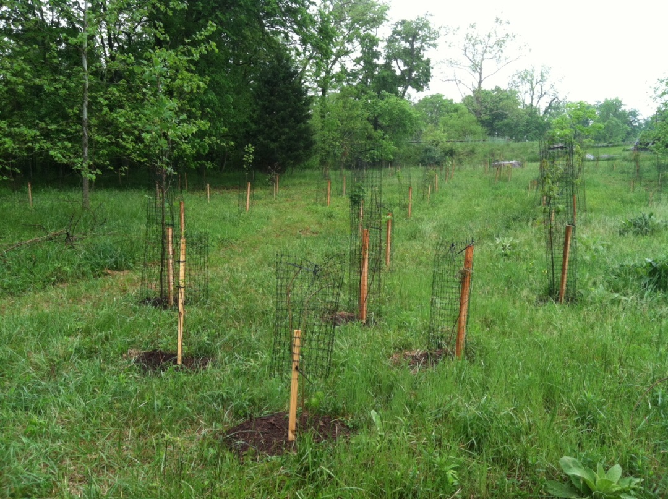
Three Gallon Plantings with and without Deer Protection

Slide 6
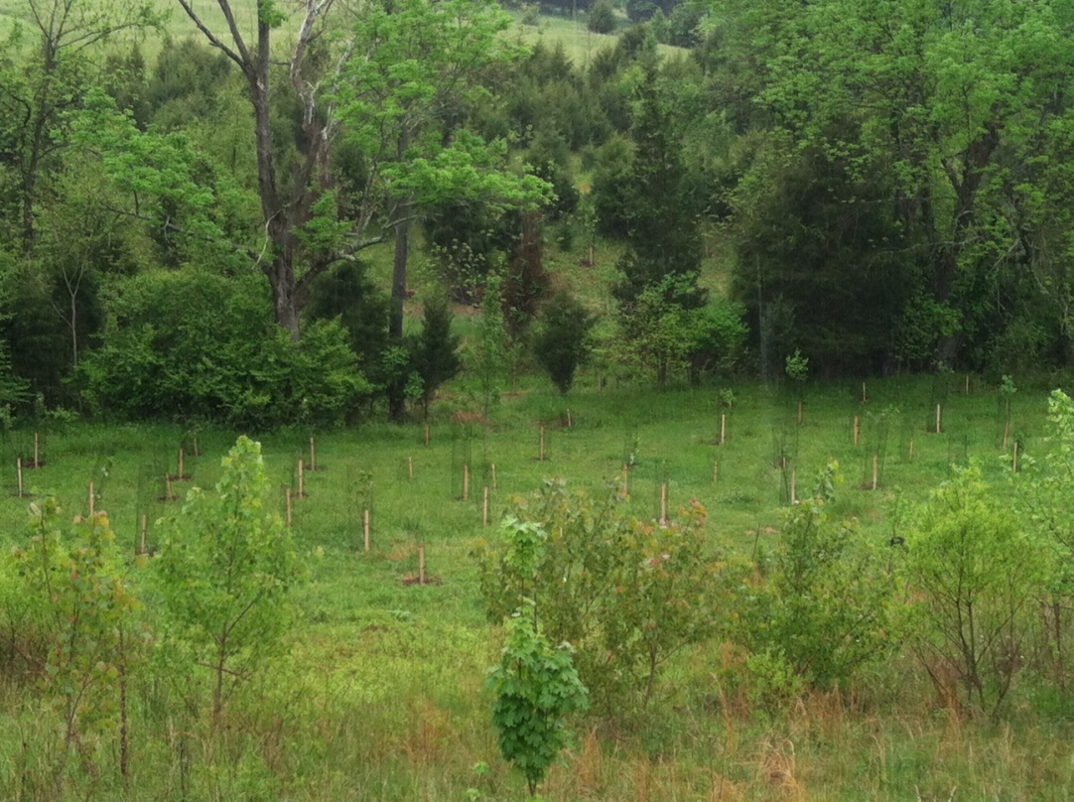
Completed Planting Examples
After Planting
Before Planting

Slide 7
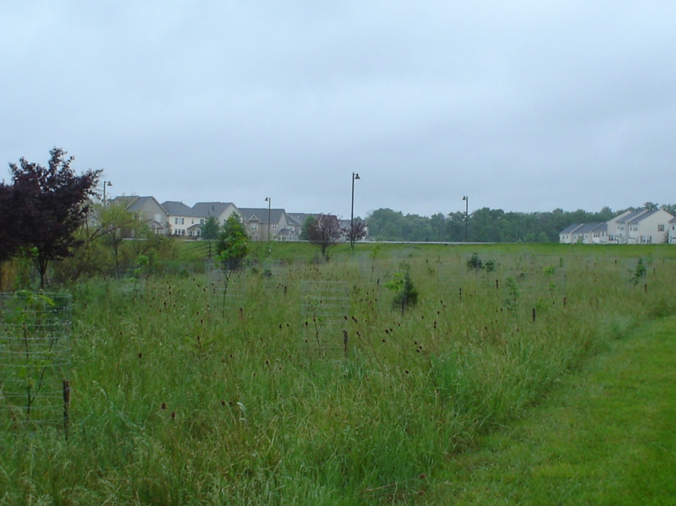
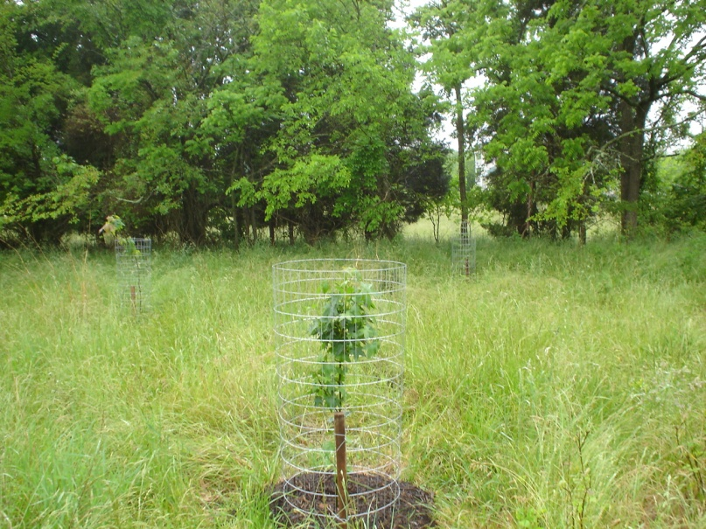
Completed Planting Examples
Before
After

Slide 8
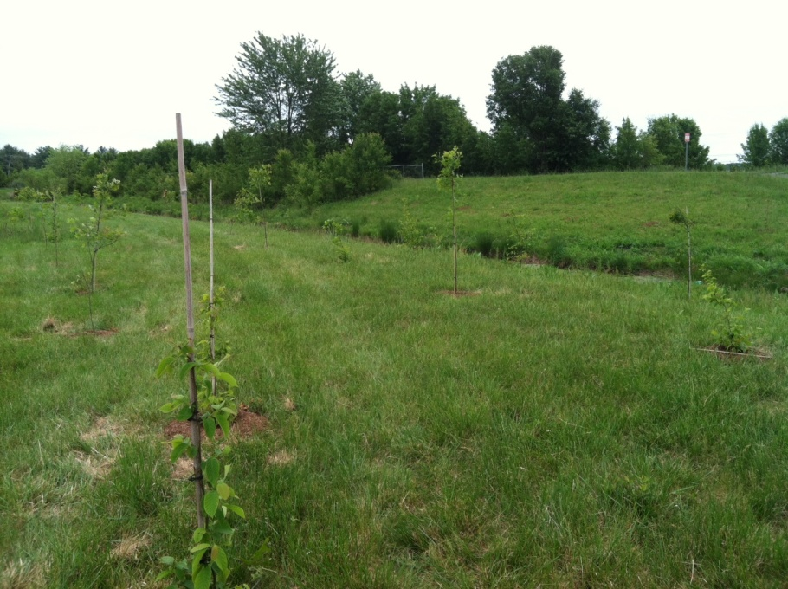
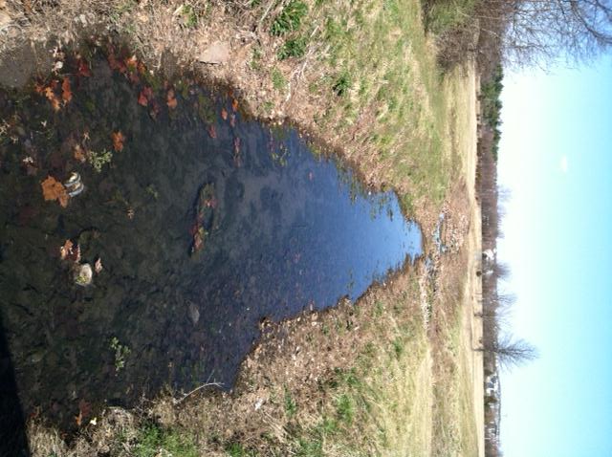
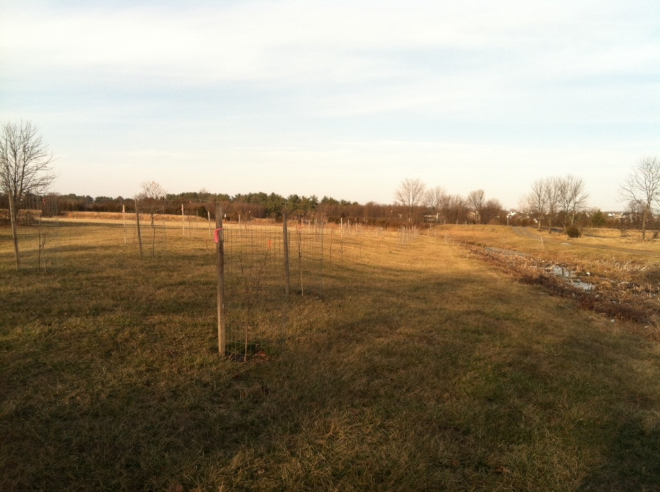
Completed Planting Examples
After
Before

Slide 9
How Does the Program Work?
Landowners submit an application noting the size and location of the proposed planting on the site.
Loudoun SWCD and Loudoun County staff will rank the projects based on criteria such as size, stream impairments, and unique characteristics (ex. Trout stream)

Slide 10
How Does the Program Work?
Applications will also include planned
species choices (eligible species list
provided)
Selected projects will be notified and
Site visits conducted to inspect
planting site and adjust plans as
needed.

Slide 11
How does the program work?
Landowners will hire a contractor, or complete plantings on their own according to approved plans and keep copies of bills, and record a declaration of restriction protecting the buffer from destruction.
Project will be inspected by District and County personnel.
Check for reimbursement will provided to the landowner.
Site will be inspected again at 1 year to check for 75% survival, if needed replanting will occur to meet this criteria at owner expense.

Slide 12
Deadlines
Applications due to Loudoun Soil and
Water Conservation District by March
1st.
Approved projects will be notified by
April 1st, and plantings shall be
Installed by May 1st.

Slide 13
Contact Information
Loudoun SWCD: 571-918-4530 ext. 107 (Chris Van Vlack)
www.lswcd.org
-Loudoun County Urban Forester: 703-771-5991 (Dana Malone)

